Slide 1
Starter – Paired Discussion Task [ 5 minutes]
Program (completed in For-loop exercises):
Ask the user to enter 10 numbers. At the end, tell them the mean average, maximum and minimum of the values entered.
Solution:
Use 10 different variables to store each number.
Tasks:
Write the advantages of using this solution.
Write the disadvantages of using this solution.
How could you simplify this code / make it more efficient?
Note: When discussing think of ‘Code Efficiency’.
Write your answers here:

Slide 2
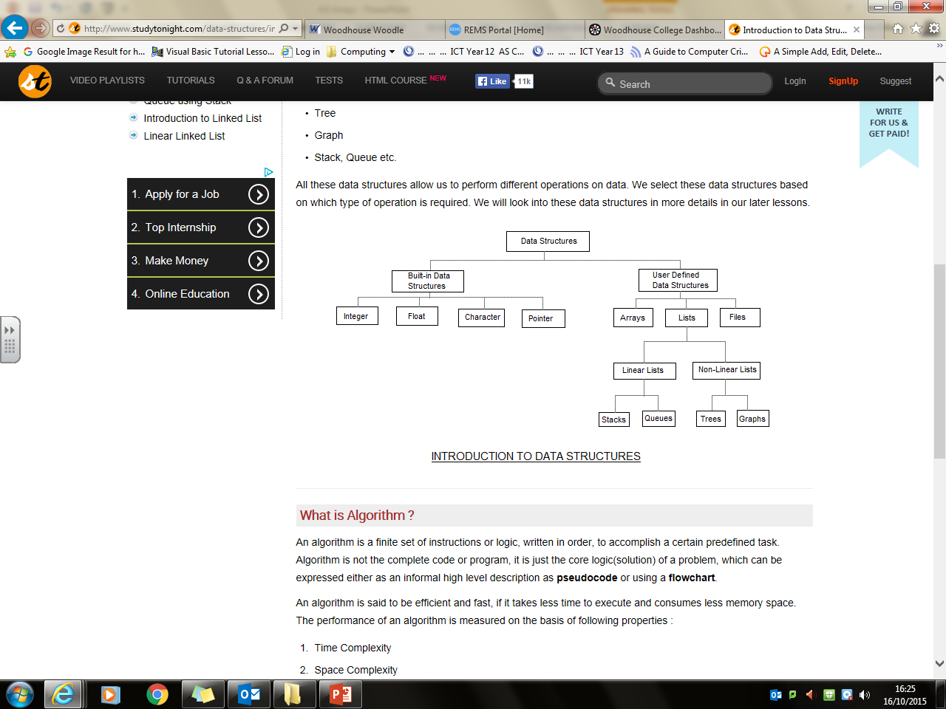
User Defined Data Structures
AS Level DS:
Arrays, Records & Files
Any method used to store data in an organised and accessible format.
Contain data that are related
Additional Reading: http://www.studytonight.com/data-structures/introduction-to-data-structures
Note:
Arrays are static – cannot grow/shrink; i.e. fixed length/size

Slide 3
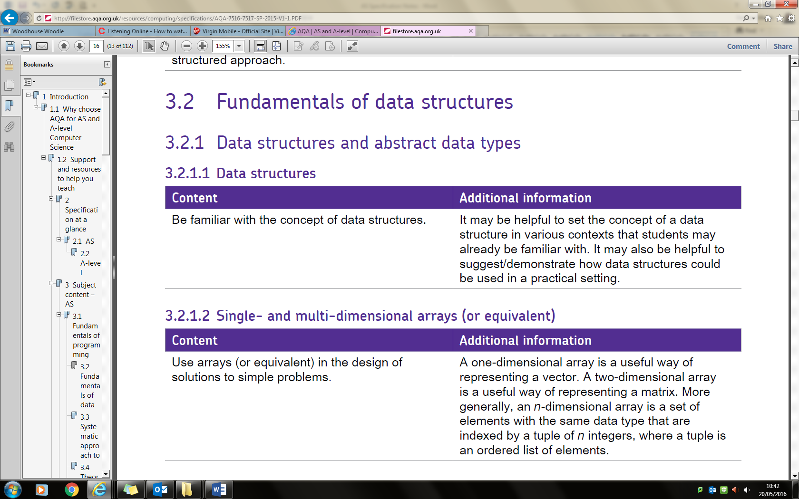
A tuple is a finite ordered list of elements. In mathematics, an n-tuple is a sequence (or ordered list) of n elements, where n is a non-negative integer. There is only one 0-tuple, an empty sequence. An n-tuple is defined inductively using the construction of an ordered pair.

Slide 4
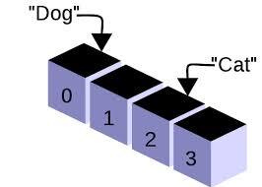
Arrays
P1
Data Structures

Slide 5

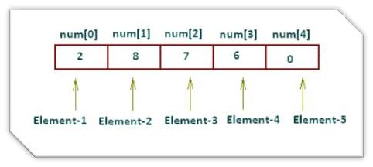
Array
each element in the array shares the same name but a different index* or subscript*.
* This is a number which indicates the position of the element in the array.
Note: In Visual Basic, the first element of an array has the subscript, 0.
An ordered set of values of a single data type

Slide 6
Declaring a Single-Dimensional Array
When we declare an array, we also specify the size of the array.
Dim names(3) As String names(0) = "Pinky" names(1) = "Perky" names(2) = "Bob" names(3) = "Bill" Console.WriteLine(names(0)) Console.WriteLine(names(2)) Console.ReadLine()
Note:
If you wish to store 5 items, you will need an array of size (4).

Slide 7
Creating & Initialise an array of Strings
Dim names() As String = {“Paula", "Peter", "Bob", "Bill"}
Output contents of the array (by postion)
Console.WriteLine(names(0))
Console.WriteLine(names(2)) Console.ReadLine()
NOTE: Single-dimensional array is a useful way of representing a vector.

Slide 8
Quick Check
Declare an array that will hold the names of your 5 best friends, call it befr.
Declare an array listing 5 animals in a zoo (aardvark, bear, zebra, deer, elephant) in alphabetical order.
Write code to output the first and last animal

Slide 9
Printing Each Element in an Array
Dim names() As String = {"Pinky", “Brain", "Bob", "Bill"}
For count = 0 To 3 Console.WriteLine("{0}. {1}", count, names(count)) Next
Console.ReadLine()

Slide 10
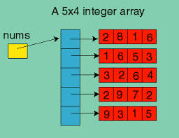
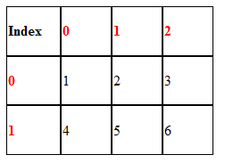
Multi-dimensional arrays
stores values in rows and columns.
Rows: 2
Columns: 3
Declared dimension is (1, 2); starting position is (0, 0)
'declares an array of 3 by 3 members which is a 9 member array Dim rectArray(2, 2) As Integer 'setting initial values Dim rectArray(,) As Integer = {{1, 2, 3}, {12, 13, 14}, {11, 10, 9}}
NOTE: Multi-dimensional array is a useful way of representing a matrix.

Slide 11
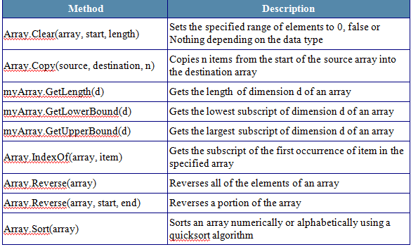
Array Class Methods

Slide 12
Individual Exercises
Initialise an array of 10 names. Output the array to the screen. Now alter your code to output the array to the screen in reverse order.
Declare an array of 10 integers. Allow the user to input the values they want. Output the sum, lowest subscript, largest subscript and mean values (must use GetLength()) from their list.
Write a program to choose 100 random numbers between 1 and 100. Count and display how many numbers are in the range 1-10, 11-20, 21-30 etc.
Hint: You might find some of the methods in the previous slide useful

Slide 13
4. Trace through the following pseudocode and complete the trace table below.
maxAge ←0
Declare array ageList[0:3]
FOR index ← 0 to 3
ageList[index] ← USERINPUT
IF ageList[index] > maxAge THEN
maxAge ← ageList[index]
position ←index
END IF
END FOR
OUTPUT AgeList[position], position
 | ageList
index | 0 | 1 | 2 | 3 | maxAge | position | Output
Test Data 12, 16, 17, 11
Notes:
PGOnline Hw 4

Slide 14
Independent Work (Challenge Task )
Compulsory
Declare an array of 7 integers. Initialise each element to 0.
D/E: Use a loop and random numbers to simulate the rolling of a single die.
B/C: If a 1 is rolled, increase the value of element 1 in the array by 1, if a 2 is rolled, increase the value of element 2 by 1.
A: When all 200 rolls have been simulated, output the tally to the console.

Slide 15
Extra Practice (Task 1) *not compulsory
A teacher uses a program that stores pupil names in an array. The array is indexed from 0, so the first element in the array is name[0]. Occasionally the teacher needs to search for a name to find the student’s record number, which is index + 1.
Write a program that will search an array name containing max elements, to find a name and output record number if it exists. If the name does not exist the user should be told the name was not found. Use appropriate prompts for input and output in your solution.

Slide 16
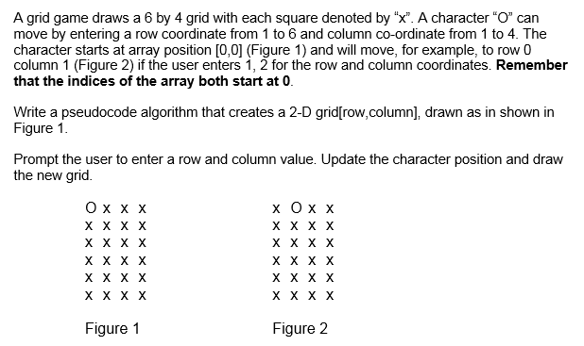
Extra Practice (Task 2) *not compulsory

